Slide 1

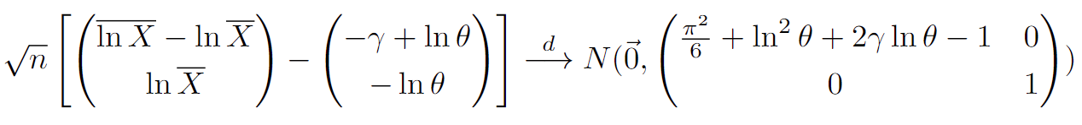
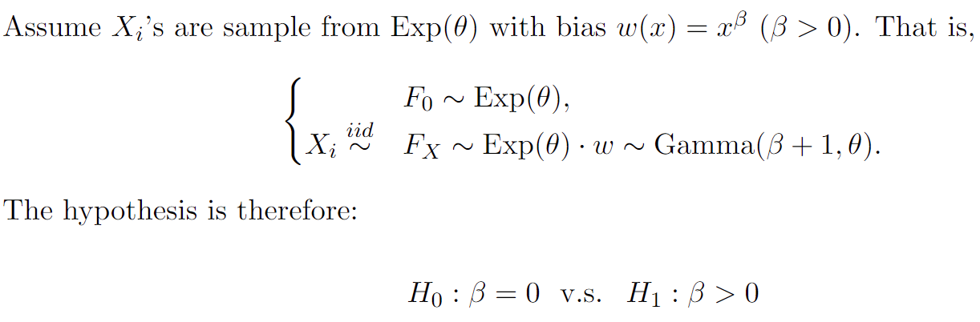
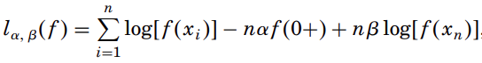
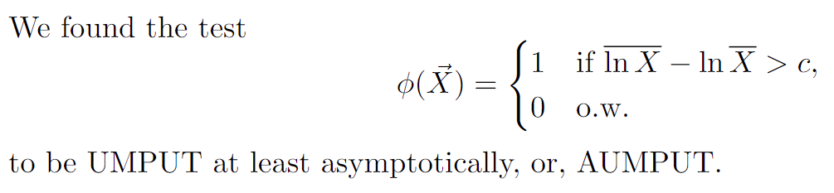
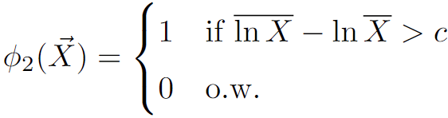
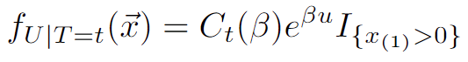
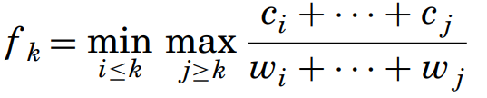
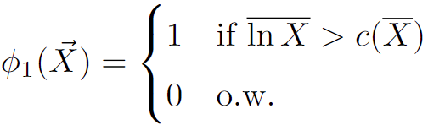
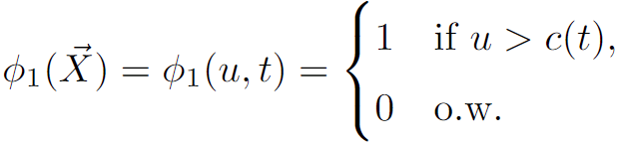
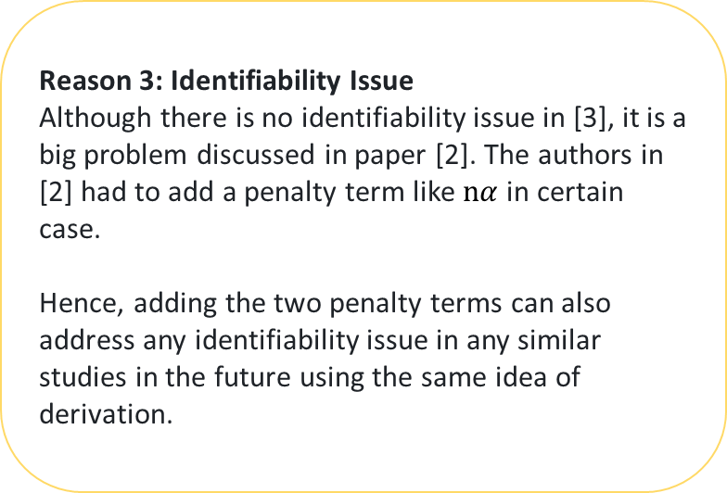
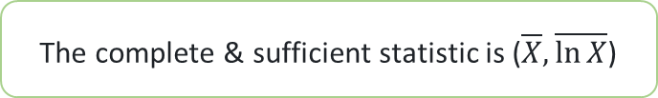
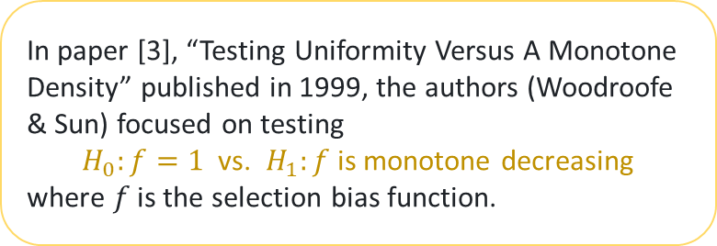
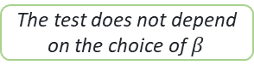
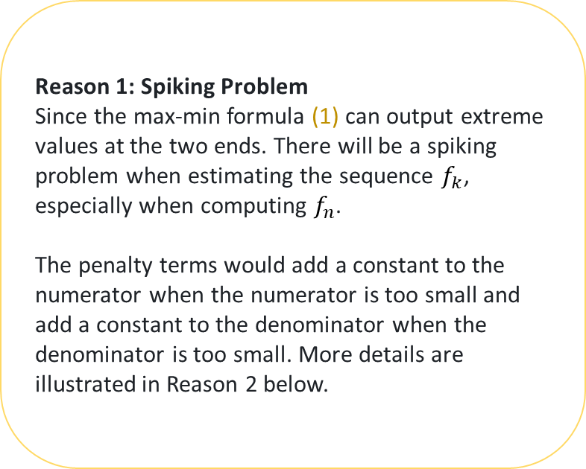

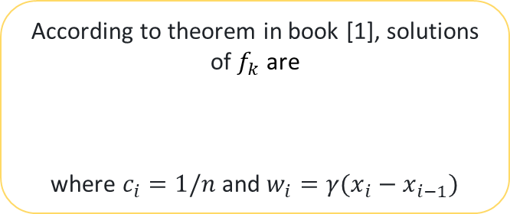
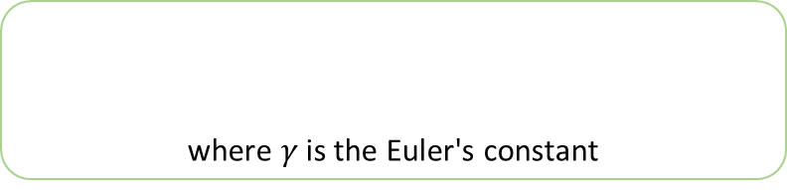
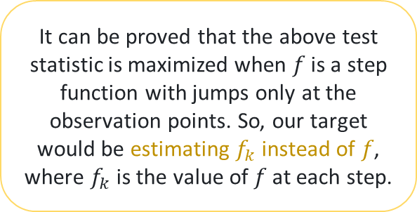
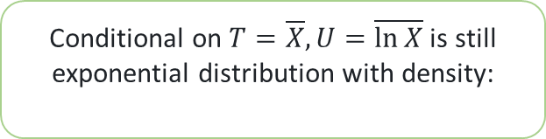
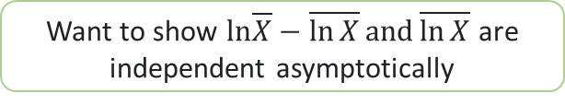
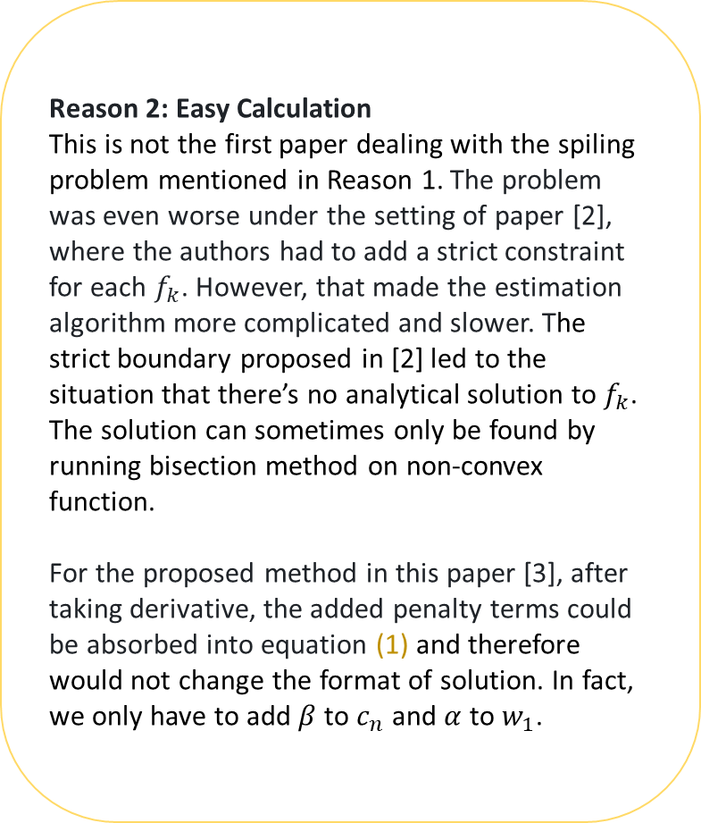
Introduction
As demonstrated in today’s early presentation by Professor Jiayang Sun, “testing for potential selection is crucial for effective decision-making”, data from observational studies, including crowdsourcing, may come with selection biases. This poster
presents ideas behind the approaches in [2] and [3], coauthored by Woodroofe, which continue to influence the development of tests for assessing selection biases; and
highlights my enjoyment in deriving an AUMPUT test that will serve as a benchmark for evaluating new selection bias tests.
Beautiful Ideas & AUMPUT for
Monotone Selection Bias Study
Presented by Zixiang Xu
Joint work with Jiayang Sun, Michael Woodroofe, Mary Meyer
Beautiful Ideas
AUMPUT
Setting:
Method:
Ideas behind the method:
The test statistic is actually the log-likelihood function plus some penalty terms, but why did the authors add those terms?
Reason 1: Spiking Problem
Since the max-min formula (1) can output extreme values at the two ends. There will be a spiking problem when estimating the sequence $f_{k}$, especially when computing $f_{n}$.
The penalty terms would add a constant to the numerator when the numerator is too small and add a constant to the denominator when the denominator is too small. More details are illustrated in Reason 2 below.
Semiparametric test is useful when selection bias is an unknown monotone function. To see its power, it is important to compare it with a good baseline test that is optimal under a parametric model.
An UMP test would be the best for us. However, in our case we have more than one parameter. Therefore, an UMPUT would be more realistic since for exponential family distribution, conditional on one of the complete and sufficient statistic, the distribution would still be from the exponential family.
Theorem:
Proof:
In paper [3], “Testing Uniformity Versus A Monotone Density” published in 1999, the authors (Woodroofe & Sun) focused on testing
$H_{0}:f=1$ vs. $H_{1}:f$ is monotone decreasing
where $f$ is the selection bias function.
Theorem proved!
where $γ$ is the Euler's constant
One test statistic immediately coming to our head is the log-likelihood function:
CLT plus Delta's method
Want to show $ln\overline{X}−\overline{\ln{X}}and\overline{\ln{X}}$ are independent asymptotically
Reason 2: Easy Calculation
This is not the first paper dealing with the spiling problem mentioned in Reason 1. The problem was even worse under the setting of paper [2], where the authors had to add a strict constraint for each $f_{k}$. However, that made the estimation algorithm more complicated and slower. The strict boundary proposed in [2] led to the situation that there’s no analytical solution to $f_{k}$. The solution can sometimes only be found by running bisection method on non-convex function.
For the proposed method in this paper [3], after taking derivative, the added penalty terms could be absorbed into equation (1) and therefore would not change the format of solution. In fact, we only have to add $β$ to $c_{n}$ and $α$ to $w_{1}$.
It can be proved that the above test statistic is maximized when 𝑓 is a step function with jumps only at the observation points. So, our target would be estimating $f_{k}$ instead of 𝑓, where $f_{k}$ is the value of 𝑓 at each step.
Unable to prove directly
The complete & sufficient statistic is ($\overline{X},\overline{\ln{X}}$)
Want to show $ln\overline{X}−\overline{\ln{X}} and\overline{\ln{X}}$ are independent
Inspired by the format of LRT:
Conditional on $T=\overline{X},U=\overline{\ln{X}}$is still exponential distribution with density:
According to theorem in book [1], solutions of $f_{k}$ are
where $c_{i}=1/n$ and $w_{i}=γ(x_{i}−x_{i−1})$
The test below is the UMPUT
(1)
Neyman-Pearson Lemma
The MP test for any simple test like above is:
with condition:
Power function is continuous
The test is the UMP similar test
Rather than using the log-likelihood function as the test statistic, the authors introduced the penalized log-likelihood function
Reason 3: Identifiability Issue
Although there is no identifiability issue in [3], it is a big problem discussed in paper [2]. The authors in [2] had to add a penalty term like $nα$ in certain case.
Hence, adding the two penalty terms can also address any identifiability issue in any similar studies in the future using the same idea of derivation.
The test does not depend on the choice of $β$
T is boundedly complete
The test is the UMP test with NS condition
The test is the UMP test for testing:
with condition:
The condition is exactly the Neyman structure condition
REFERENCES:
[1] Robertson, T., F. Wright, and R. Dykstra (1988). Order Restricted Statistical Inference. Probability and Statistics Series. Wiley.
[2] Sun, J. and M. Woodroofe (1996, 09). Semi-parametric estimates under biased sampling. Statisticaa Sinica 7.
[3] Sun, J. and M. Woodroofe (1999). Testing uniformity versus a monotone density. The Annals of Statistics 27 (1), 338–360.

Slide 2
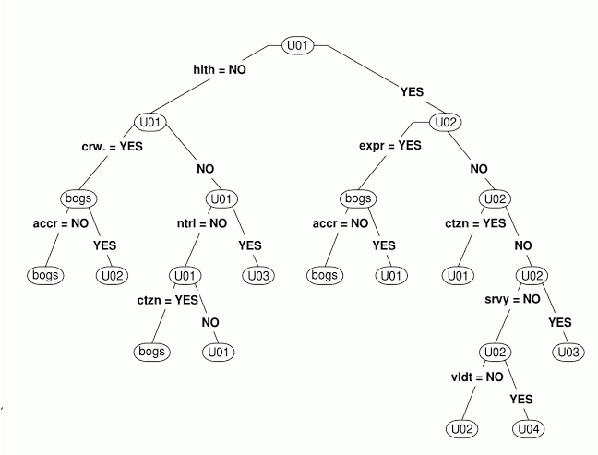
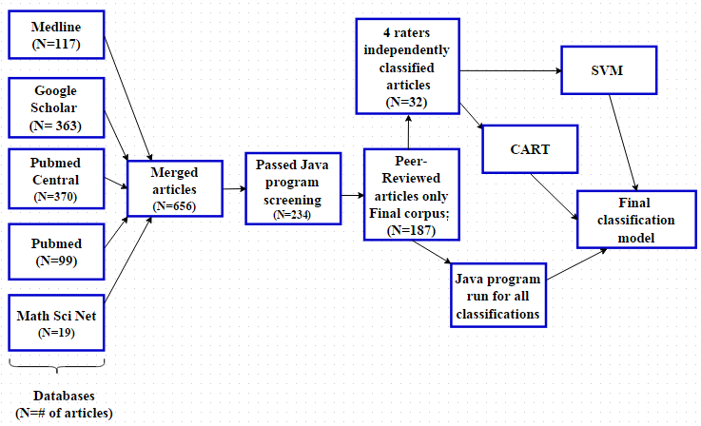
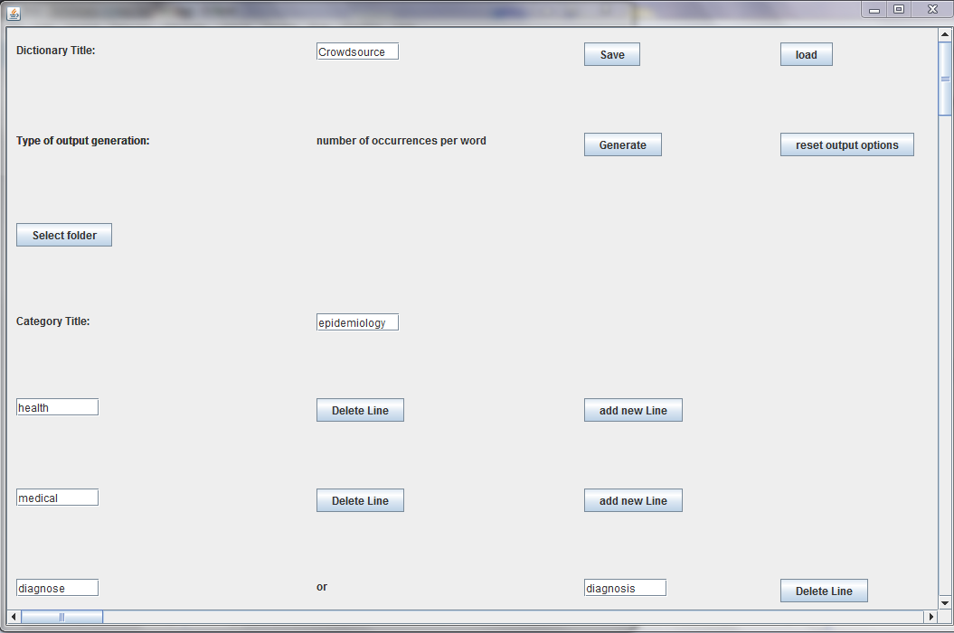
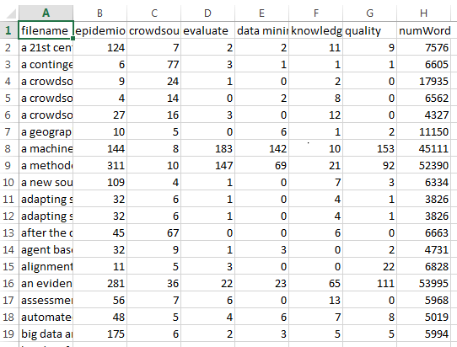
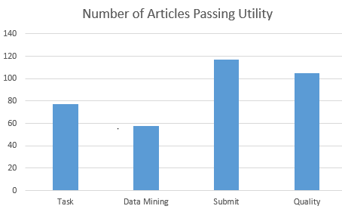


Crowdsourcing in Epidemiology: Current Utilities, Trends and Standards
Katie Pezzot¹⁻², Rebecca Carter³⁻⁴, Jiayang Sun³⁻⁴
¹The Department of Mathematics, Applied Mathematics and Statistics, Case Western Reserve University, Cleveland OH
²Department of Electrical Engineering and Computer Science, Case Western Reserve University, Cleveland OH
³Center for Statistical Research, Computing and Collaboration (SR2c), Case Western School of Medicine, Cleveland OH
⁴Department of Epidemiology and Biostatistics, Case Western School of Medicine, Cleveland OH
Introduction
Definition
Results
CART
Crowdsourcing outsources tasks to the masses through the internet and is a promising new method of gathering large amounts of information in a short period of time
Epidemiological studies serve as the cornerstone of public health
There are unique challenges for epidemiological crowdsourcing in design, data safety, and quality control
Crowdsourcing is gathering information generated or obtained by internet users. Users can either knowingly contribute content or have posted data via a crowdsourcing or social media website.
Concept Map
Inclusion Criteria
Peer reviewed publication
Crowdsourcing done online
Papers involved epidemiology
Our Objective
Utilities
Identify the utilities, trends, and challenges, and propose several guidelines in crowdsourcing in epidemiology
Users complete tasks that do not require user information to complete
Social media data mining
Users submit information known to them
Quality control methods or discussion
Methods
Prescreening: Searched 5 databases for crowdsourcing articles using a combination of key word search and a XML-crawler implemented in R
Dictionary Generation: Created dictionaries of relevant words based on domain knowledge and searched articles pertaining to the subject
Determination of Utilities: Classified the four utilities
Program Development: Developed a java program to text mine articles based on the dictionary and return a csv file of the counts of the dictionary as output
Second Screening: Used a java program to screen out non crowdsourcing or non-epidemiology articles
Quality Control: Removed non peer reviewed articles
Benchmarking: Classified a subset of the articles by 4 calibrated raters independently
Model Development: Used SVM and CART to develop a classification model/tool based on the bench data
Analysis: Analyzed all data using the classification tool and compared it with java counting of the outcomes
Dictionary Outcomes
Conclusions
Trends in Utilities
Utility 1. Most articles focus on crowdsourcing games that require user actions such as classification or annotation
Utility 2. Twitter or crowdsourcing websites (ex: 23AndMe) are the primary focus. Data mining strategies are used to analyze the data
Utility 3. Many online surveys are generated. Amazon Mechanical Turk is the most popular platform
Utility 4. Crowdsourcing quality control methods are highly variable. Some articles demonstrate well designed quality control, some have none.
General Trends
Crowdsourcing terminology is non-uniform
Crowdsourcing is being used in a wide variety of applications
Recommendations
Crowdsourcing is powerful, but not a panacea
Standards of experiment design apply in addition to a few methods specific to online tasks involving clarity, monitoring and quality control
Analysis needs to filter out poor performing workers
Quality control needs to become a greater part of the crowdsourcing process
The main interface for the java program. Users can create, save, or load dictionaries. From the dictionary, output is generated based on the folder that is selected.
Output that displays the number of hits for each category, on the top row, for each article on the left column.
Words with similar meaning to “Crowdsourcing”
Alternate spelling: crowd-source, crowd source
Microtask: workers complete small tasks that contribute to the larger task.
Megatask: workers compete to do a large task the best.
Citizen Science: Scientific research primarily conducted by a group of amateurs.
Open Source: information is accessible and can be modified by the public.
Micro-monetary Incentives: Giving small amounts of money to workers to complete crowdsourcing tasks.
Histogram showing the number of articles that were classified by the dictionary as being part of each utility.
References:
Ranard, Benjamin L., et al. "Crowdsourcing—harnessing the masses to advance health and medicine, a systematic review." Journal of general internal medicine 29.1 (2014): 187-203.
Good, Benjamin M., and Andrew I. Su. "Crowdsourcing for bioinformatics.“ Bioinformatics (2013): btt333.

Slide 3

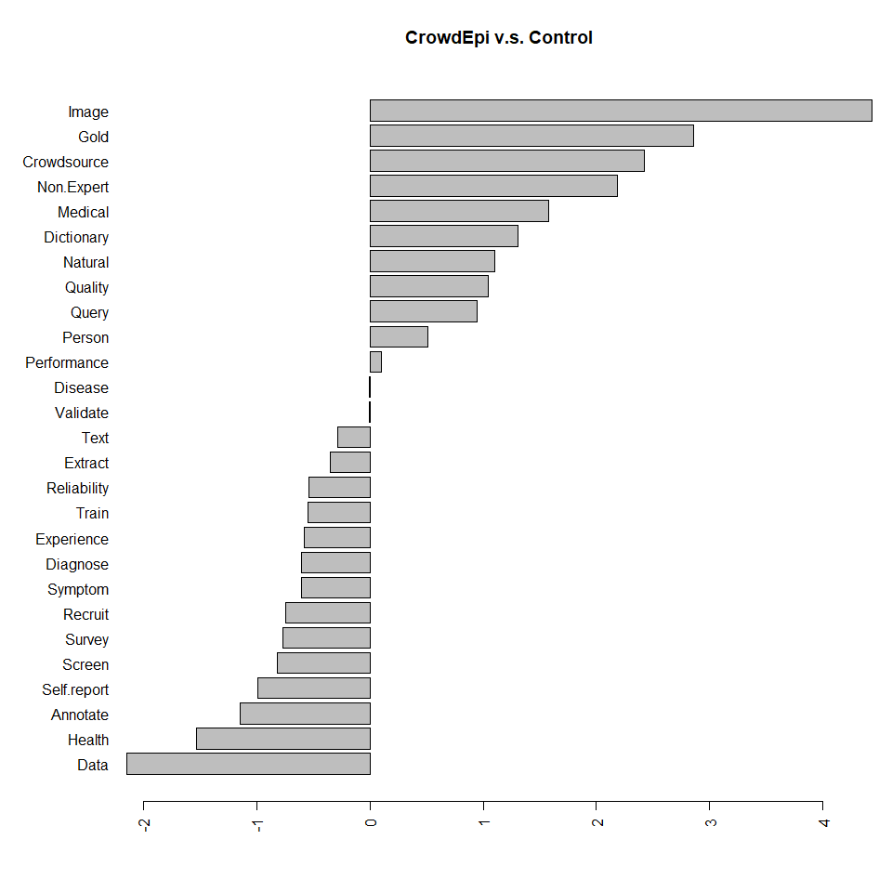
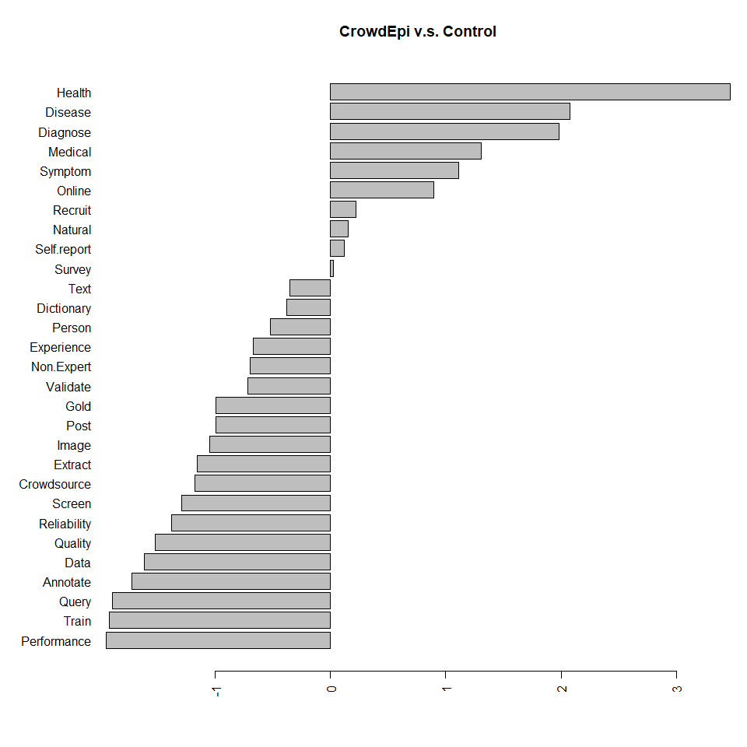


Slide 4


METHODOLOGY
The research is divided into 5 steps:
The target article ID lists were directly exported from PubMed official to text files using the package “xml2” in R; website;
The target articles were retrieved by using the BioC API in R, with an output format of XML files;
The XML files were converted
A Java program was developed to retrieve key word counts from the given text files;
EDA (Exploratory Data Analysis) was implemented to investigate underlying trends of the key words obtained.
Figure 1: Java program interface

Slide 5
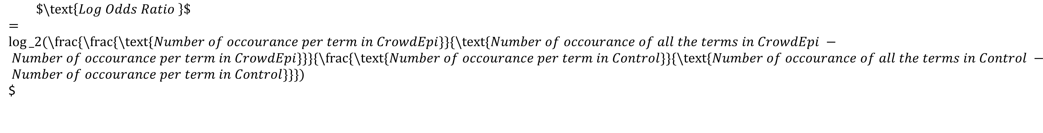
$$\$\backslash text\left\{Log Odds Ratio \right\}\$$$
$=log⁡_2(\backslash frac\{\backslash frac\{\backslash text\{Number of occourance per term in CrowdEpi\}\}\{\backslash text\{Number of occourance of all the terms in CrowdEpi − Number of occourance per term in CrowdEpi\}\}\}\{\backslash frac\{\backslash text\{Number of occourance per term in Control\}\}\{\backslash text\{Number of occourance of all the terms in Control − Number of occourance per term in Control\}\}\})$$

Slide 6
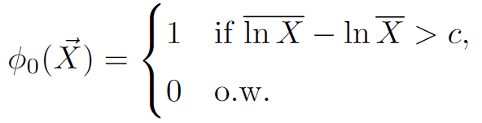
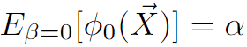
Sampling from obs study is important!
… J. Sun, K. Pezzot, R. Carter
Although it now has a new terminology ——
crowdsourcing
We did the following trend study for crowdsourcing related articles in the field of epidemiology.
Crawl XML files from PubMed Central with the BioC API in R
is the AUMPUT with condition
Separate into two groups: Period 1 (before 2017) and Period 2 (after 2017)
Convert XML files to TEXT files
Develop a keyword dictionary
Develop a JAVA program to automatically count the number of appearances of the keywords from all the downloaded articles
(See Figure 1)
Data analysis
The counting's of the keywords reveal underlying trends
Conclusion: Crowdsourcing is popular today especially after the pandemic ...
Figure 1: Java program interface

